Slide 1
Credit Card Marketing Strategy
By Naeemah Small

Slide 2
Abstract
In the financial industry, companies create revenue when customers accept credit card offers. I wanted to know what is the most effective way in order to market a credit card to new customers? I used a dataset from data.world and conducted random surveys with friends, family and co-workers. The intended findings for the research is finding out which marketing method and rewards in more appealing to customers, which customers should can be targeted in accepting a credit card offer.

Slide 3
Motivation
In the Huffpost (https://www.huffingtonpost.com/scott-gamm/banks-spend-83-million-to_b_778709.html) “Around 83 million dollars are spend promoting credit cards to college students which gain only 53,164 return in new issuers”. This is only for young college students.
My motivation is to reduce the budget of dollars spent while gaining more credit card users. By creating a credit card marketing model, you can target specific new customers knowing a large percentage will accept an offer, than not – for all people of different walks of life.
By creating a marketing model:
We can focus on key factors
How to tailor a marketing campaign to focus on people who would say “No” to an offer
Eliminating rewards that people are not interested in

Slide 4
Dataset
The dataset came from https://data.world/gautam2510/credit-card-dataset.
Observations: 18000
Offer Accepted: Yes = 1023, No = 16977
Offer Accepted Proportion: Yes = 0.057, No: 0.943
Reward: Air Miles = 6061, Cash Back = 5999, Points = 5940
Reward Proportion: Air Miles = 0.337, Cash Back = 0.333, Points = 0.330
Mailer Type: Letter = 8853, Postcard = 9147
Mailer Type Proportion: Letter = 0.492, Postcard = 0.508
Income Level: High = 4526, Medium = 9013, Low = 4461
Credit Rating: High = 6071, Medium = 5972, Low = 5957
Credit Cards Held : Min = 1, Max = 4
Household Size: 1 = 539, 2 = 2813, 3 = 5712, 4 = 5543, 5 = 2853, 6 = 538, 8 = 1, 9 = 1
Average Balance: Min = 0, Max: 3366

Slide 5
Data Preparation and Cleaning
I separate the dataset into 3 files: Yes to offer, No to Offer and Yes/No to Offer
I checked each file for null values by using df.isnull().any() and the clean did not obtain nulls
I reduce the dataframe to only: Customer Number, Reward, Income Level, Credit Rating, Credit Cards Held, Household Size, Average Balance
I used df.dropna(axis=0) to finally clean the dataset
The “Yes” file is to understand why a customer accepted the offer
The “No” file is to understand why a customer did not accept the offer
The “Yes/No” files is to create a marketing model for machine learning

Slide 6
Research Questions
Which marketing method is more effective in marketing a credit card?
Which rewards are more popular than others?
Which group of customers would accept an offer?
Understanding why customers would not accept an offer?
Which new customers should a marketing campaign focus on?

Slide 7
Methods
When analyzing the data, I separated the my research into 4 parts.
The “Yes to Offer” dataframe is to understand why a customer accepted the offer
The “No to Offer” dataframe is to understand why a customer did not accept the offer
The “Yes/No to Offer” dataframe is to create a marketing model for machine learning and comparing Yes and No offers
Regression Analysis, Prediction and Machine Learning
In the Yes and No section
I looked into: Rewards, Income Level, Credit Rating, Mailer Type, Credit Cards Held, Average Balance. I explored the data using tables and graphs I needed to know
Which Rewards were most/less popular: In the analysis, Points and Airlines Miles are more popular than Cash Back
Income Level to target: Low is a guarantee: “Yes”, High is a guarantee “No”, Middle is a mix of “Yes/No”
Credit Rating to target: Low is a mix of “Yes/No”, High is a soft “No”, Middle is a mix of “Yes/No”
Which Mailer Type is more effective: Postcard is more effective than using a Letter.
In credit cards held, group should be targeted: 1 to 2 cards is a good target in order to get more customers
Average Balance held to target: 751.7 to 1127.55 dollars
In the “Yes/No” section
The test my “Yes” and “No’ findings
In section in the “Regression Analysis, Prediction and Machine Learning” section
I created a marketing model and tested.
Accuracy: 93% Error : +/- 2%

Slide 8
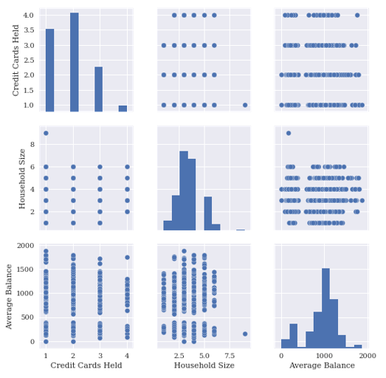




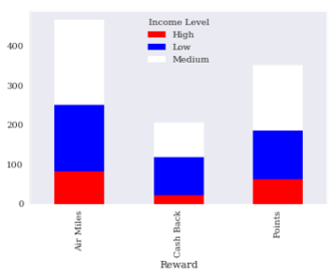
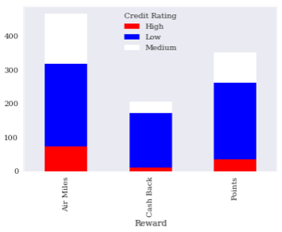
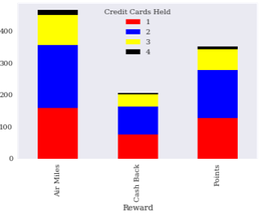
“Yes” to Offers
In Rewards, it is more customer would get credit card that will deal Points and Airlines.
Points can be redeemed for a variety of items, including merchandise, airfare, hotels, gift cards or cash back, this is good reward for the average customer.
Airlines miles known as frequent flyer miles. You can use this miles to buy tickets.
Cash back reward is when a percentage of the amount spent is paid back to the card holder.
Guarantee “Yes”
Most people don’t pay there credit cards on time; which would assume that companies have a bill colleting department credit cards, makes it more likely people with a low credit rating would say “Yes” to an offer. They are charging or maxing out their cards.
Most people with a Income Level of Medium would say “Yes” to an offer. This group can buy now and pay later.
People are most likely to say “Yes” to an offer if they already have 2 credit cards.

Slide 9
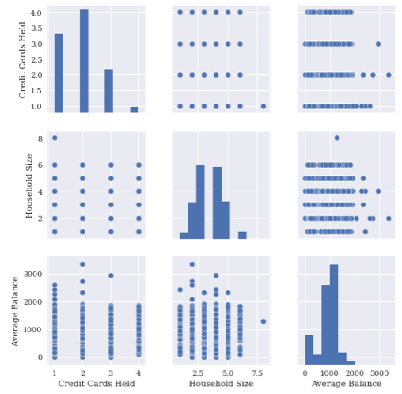




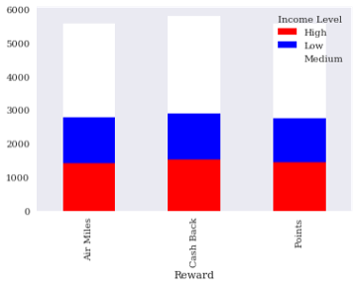
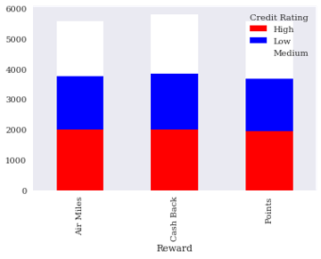
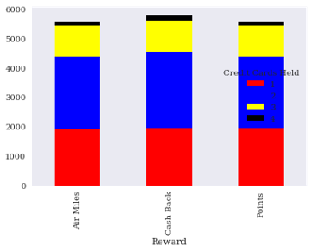
“No” to Offers
In Rewards, it is more customer would get credit card that will deal Points and Airlines.
Points can be redeemed for a variety of items, including merchandise, airfare, hotels, gift cards or cash back, this is good reward for the average customer.
Airlines miles known as frequent flyer miles. You can use this miles to buy tickets.
Cash back reward is when a percentage of the amount spent is paid back to the card holder.
Need to get them to say “Yes”
It is more likely people with a Low credit rating would say “Yes” to an offer with convincing. People with High would “No” to an offer, in order to keep a High rating.
The most likely to target is the Medium with convincing marketing campaign. Since they do have an Medium Credit Rating, customers are open to better incentives.
Most people with a Income Level of Medium would say “Yes” to an offer. This group can buy now and pay later.
For credit cards held, target a customer with 1 or 3 credit cards

Slide 10
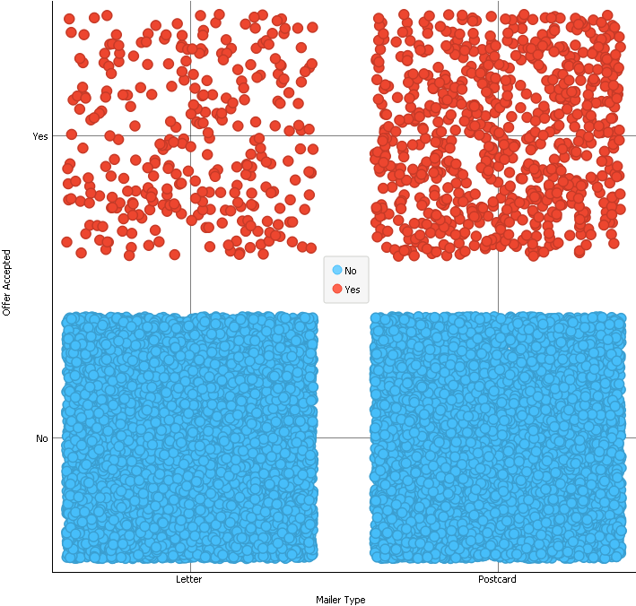
Marketing Style
In the “Yes” to offers, we see that customers would prefer a postcard instead of a letter.
In customers does not want a credit card, they will say “No” to an offer regardless the marketing style.

Slide 11

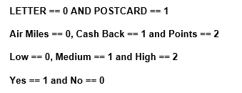
Target
Based on prediction:
Target the High Income customers who would “No” to a “Yes” with rewards, education about credit cards and how they are different from debit cards.
Customers with 2 credit cards would likely accept a 3 credit card with convincing.
Customers with High Income most likely travel, so Air Miles will work follow by Points for Rewards.
Using Post Cards is the best way to market. It’s fast, easy to read and based on colors; easy to spot.
Accuracy score: 94% (0.939) Error: 2% (0.235)
Mail type is using a post card.
Reward is Airline Miles
Income level is High
Credit Cards Held is 2

Slide 12
Limitations
The limitations of the data is follows:
Year is unknown
Credit Card type unknown
Data does not include country, company, or certain place
Gender is unknown
The main idea for the dataset is to create a marketing model.

Slide 13
Conclusions
In the financial industry, companies create revenue when customers accept credit card offers. By using the research information and by asking co-workers, family members and random people - I have developed an effective marketing model for credit cards.
Q) Which marketing method is more effective in marketing a credit card?
A) Post Cards with flashy colors that will stand out in a pile of mail.
Q) Which rewards are more popular than others?
A) Customers who frequency travel will like Air miles Rewards, while other customers would prefer the Points Rewards because they can use for anything. By educating customers you can convince customers the differences between Cash Back and Points.
Q)Which group of customers would accept an offer?
A)I thought if we target the Medium Income, customers will say “Yes” , but the predication model mention that the High Income customers should be targeted. Most likely they have debit cards, but in educating the customer to see how valuable a credit card will be for their credit for other products and benefits.
Q)Understanding why customers would not accept an offer?
A)Customers with a high credit rating may believe that a credit card will ruin their credit rating. As I have found out for myself and others, education about credit cards is important. For example, I don’t have a credit card because of my lack of education and wanting to keep my high credit rating. Having credit card does not mean you have to max it out.
Q)Which new customers should a marketing campaign focus on?
A) a) Target the High Income customers who would “No” to a “Yes” with rewards, education about credit cards and how they are different from debit cards.
b) Customers with 2 credit cards would likely accept a 3 credit card with convincing.
c) Customers with High Income most likely travel, so Air Miles will work follow by Points for Rewards.

Slide 14
Acknowledgements
I would like acknowledge data.world for providing my data and the idea.
My company because I work in the financial field.
My co-workers, family and random people on street. By asking them my research questions, I was able to prove my marketing model is correct.
One of the Credit Card department head, thought that my research was interesting.

Slide 15
References
Credit Card Marketing Budget https://www.huffingtonpost.com/scott-gamm/banks-spend-83-million-to_b_778709.html
Dataset https://data.world/gautam2510/credit-card-dataset
Top Credit Cards:
Capital One Venture Reward Credit Card
Capital One Venture One Rewards Credit Card
Chase Sapphire Preferred Card
Blue Cash Preferred Card from American Express
Citi Double Cash Card
Citi Diamond Preferred Card
Citi Simplicity Card
Discover it Cashback Match
Capital One Spark Cash for Business
Chase Slate

